Slide 1

Data Mining
Presenter: Ayush Tuladhar
Bsc. CSIT 1st Semester

Slide 2
Introduction
process of extracting and discovering patterns in large data sets
the goal is the extraction of patterns and knowledge from large amounts of data, not the extraction(mining) of data itself
to enable better decision-making or a better understanding of the world around us

Slide 3
Techniques
Association Rule Mining
Classification
Clustering
Anomaly Detection

Slide 4
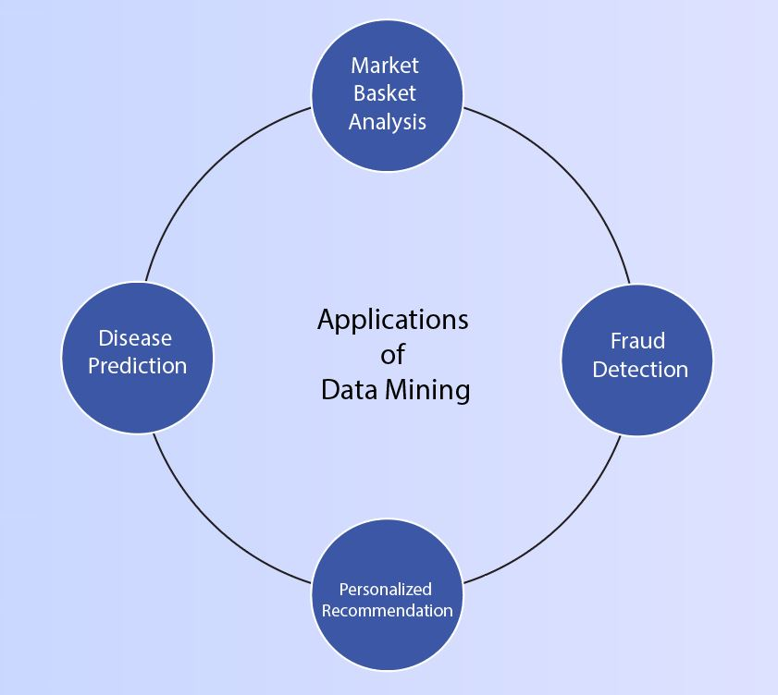
Applications

Slide 5
Challenges
Data quality issues
Scalability issues
Ethical considerations

Slide 6
Future Trends
Deep learning
Big data analytics
Integration with IoT (Internet of Things)
Integration with Artificial Intelligence (AI)

Slide 7
Conclusion
unlocking valuable insights from data, to make informed decisions
optimize processes, identify opportunities, mitigate risks, and innovate
continuous learning and exploration, encouraging dive deeper into data analysis and experimentation to drive further innovation and decision-making improvements

Slide 8
Thank You!
Any questions?

